Slide 1
CSL 859: Advanced Computer Graphics
Dept of Computer Sc. & Engg.
IIT Delhi

Slide 2
Tracing Rays
Trace many more rays

Slide 3
Tracing Rays
Not just in the ideal specular directions

Slide 4
Tracing Rays
Could distribute rays based on surface property

Slide 5
Rendering Equation
The total light leaving a point =
  Exitance from the point +
  Incoming light from other sources reflected at the point
_{Light leaving}
_{Exitance}
_{Sum}
_{BRDF}
_{Incoming}
_{light}
Incoming light reflected at the point

Slide 6
Photorealistic Lighting
Solve the equation
  To compute light leaving x, need to find how much light reaches it
  To find how much light reaches x, need to compute light leaves every other point
  Hard because BRDFs are high dimensional
  But some light interaction in the scene is diffused
    View angle independent

Slide 7
Global Illumination
Traditional Raytracing only considers specular reflections
  Does not account for (indirect) diffused reflections reaching eye
Need to “trace” those rays also
  Stochastic methods
  Monte Carlo techniques to solve rendering equation
Separate diffused and specular reflection
  Radiosity

Slide 8
Radiosity Assumptions
All surfaces are perfectly diffuse
Illumination is constant over a patch
  Subdivide triangles into small patches
    Problems at sharp illumination boundaries, e.g., shadows
    Less space/time efficient solutions
    Discontinuity meshing
Can be pre-computed
  With view-dependent illumination computed and added later

Slide 9
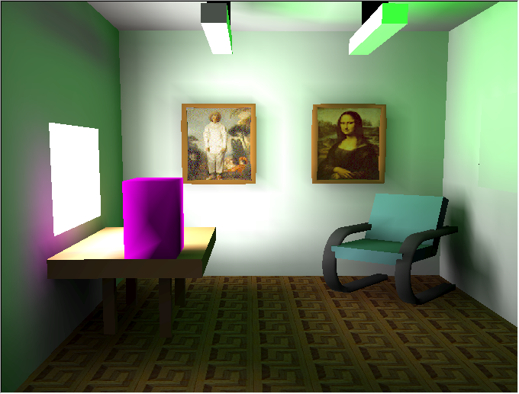
Radiosity Example
Extreme color bleeding here
Textures are post illumination
Notice meshing artifacts like the banding around the pictures on the wall
From Alan Watt, “3D Computer Graphics”

Slide 10
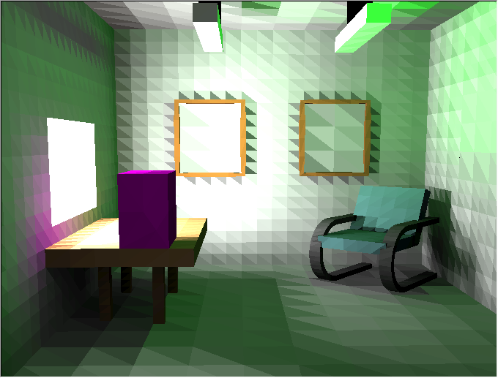
Radiosity Meshing
Each patch is colored with its illumination
The previous image was obtained by pushing color to vertices and then Gourand shading
From Alan Watt, “3D Computer Graphics”

Slide 11
Global Illumination
What’s wrong with factoring into Radiosity and Ray-tracing?
Factor into direct illumination + indirect illumination
Indirect illumination is the hard part
But:
Indirect illumination has low variance
  Can be sampled and interpolated (with care)

Slide 12
Photon Mapping
[Jensen]

Slide 13
Two-Pass Algorithm
Pass 1:
  Photons are generated and traced
  They are associated with surface points and stored
  Photon Map is created
  View independent pass
Pass 2
  Photon map is a static and used to
    Compute estimates of the incoming flux and the reflected radiance at any point in the scene
    Look up indirect illumination from Photon map
    Or, Trace rays once and then look up illumination

Slide 14
Photon Tracing
Indirect illumination on diffuse surfaces
Trace photons from the light sources
  Store them at diffuse surfaces
Brighter light => More Photons
  Photons of uniform flux
  Diffuse point light emits in uniformly distributed random directions
  Directional light emits in its direction
  Square light source emits from random positions on the square
    with directions limited to a hemisphere
Photon emission should follow light’s emission properties
  Controls origin and direction of each photon
  Cosine distribution (more photon’s emitted perpendicular to light)

Slide 15
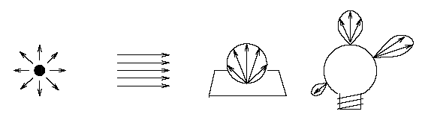
Photon Origination
P_{photon}= P_{light} / n_{photon}

Slide 16
Photon Distribution
Importance sampling
  Multiple light sources
Projection map
  Project a bounding sphere for objects
  Photons not wasted on background

Slide 17
Photon Interactions
On intersection, a photon can be
  Reflected, transmitted, or absorbed
  Probabilistic method based on the material properties
  Russian roulette
    Roll a dice and decide next step for the photon
    Controls count not the power of the reflected/transmitted photon

Slide 18
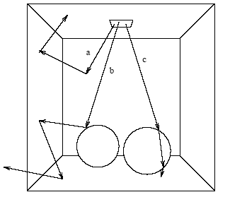
Photon Paths in Cornell Box
Chrome sphere (left) and Glass sphere (right)
(a) Two diffuse reflections followed by absorption
(b) Specular reflection followed by two diffuse reflections
(c) Two specular transmissions followed by absorption

Slide 19
Monochromatic Photon Behavior
Consider monochromatic simulation
Reflective surface with
  Diffuse reflection coefficient d
  Specular reflection coefficient s (with d + s <= 1)
Uniformly distributed random variable X ϵ [0, 1]
Sample X. If
  X ϵ [0, d] => diffuse reflection
  X ϵ ]d, s + d] => specular reflection
  X ϵ ]s + d, 1] => absorption

Slide 20
“Chromatic” Photons
Probability P_{d} for diffuse reflection =
  MAX(d_{r}P_{r}, d_{g}P_{g}, d_{b}P_{b}) / MAX(P_{r}, P_{g}, P_{b})
  where (d_{r}, d_{g}, d_{b}) are the diffuse reflection coefficients
  (P_{r}, P_{g}, P_{b}) are the powers of the incident photons
Probability P_{s} for specular reflection is
  MAX(s_{r}P_{r}, s_{g}P_{g}, s_{b}P_{b}) / MAX(P_{r}, P_{g}, P_{b})
  where (s_{r}, s_{g}, s_{b}) are the specular reflection coefficients
Instead of MAX, probabilities can also be based on total power

Slide 21
Chromatic Photon Behavior
Sample X. If
  X ϵ [0, P_{d}] => diffuse reflection
  X ϵ ]P_{d}, P_{s} + P_{d}] => specular reflection
  X ϵ ]P_{s} + P_{d}, 1] => absorption
The power of the reflected photon must change
If specular reflection was chosen:
  P_{refl,r} = P_{inc,r} s_{r}/P_{s}
  P_{refl,g} = P_{inc,g} s_{g}/P_{s}
  P_{refl,b} = P_{inc,b} s_{b}/P_{s}
    where P_{inc} is the power of the incident photon
Similarly for diffused and absorbed photons

Slide 22
Photon Map
Photons are only stored where they hit non-specular surfaces
Global data structure: photon map stores
  Position
  Incoming photon power
  Incident direction
  A flag for help with sorting and look-up
For participative media, one might construct a volume photon map
Notes:
The reason is that storing photons on specular surfaces does not give any useful information: the probability of having a matching incoming photon from the specular direction is zero, so if we want to render accurate specular
reflections the best way is to trace a ray in the mirror direction using standard raytracing.
Note that each emitted photon can be stored several times along its path. Also, information about a photon is stored at the surface where it is absorbed if that surface is diffuse.

Slide 23
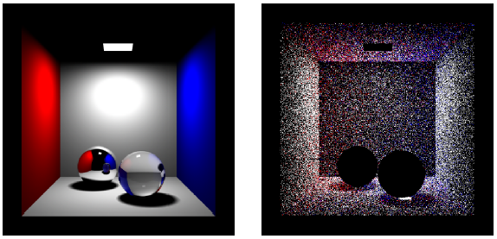
Example
Raytraced image (direct
illumination, specular
reflection and transmission)
(b) Photons in the
photon map.
Images courtesy of Henrik Wann Jensen

Slide 24
Participative Media
Photons can be emitted from volumes (and surfaces and points)
Probability of being scattered or absorped in the medium depends on
  Density of the medium
  Distance the photon travels through the medium
    The denser the medium, the shorter the average distance before a photon interaction happens.
Photons are stored at the positions where a scattering event happens
  Exception photons directly from the light source
  Direct illumination is evaluated using ray tracing
  Not necessary, but this separation improves efficiency

Slide 25
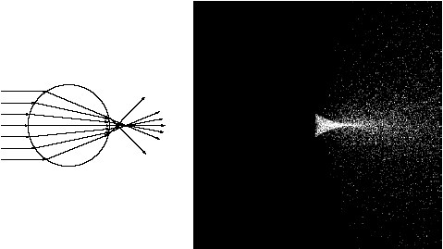
Participative Medium
Glass sphere in fog illuminated by directional light
Images courtesy of Henrik Wann Jensen
Notes:
Only shows the photons after refraction and the photon paths are terminated at the first scattering.
Multiple scattering is simulated simply by letting the photons scatter everywhere and continuously after the first interaction.
The path can be terminated using Russian roulette.
The fog in the example has uniform density, but for nonuniform density media, use ray-marching
to integrate the properties of the medium. A simple raymarcher works by dividing the medium into little steps. The accumulated density (integrated extinction coefficient) is updated at each step, and based on a precomputed probability it is determined whether the photon should be absorbed, scattered, or whether another step is necessary.

Slide 26
Three Photon Maps
Caustic photon map
  Photons that have been through at least one specular reflection before hitting a diffuse surface: LS+D.
Global photon map
  Approximate representation of the global illumination solution
  Scene for all diffuse surfaces
Volume photon map
  Indirect illumination of a participating medium

Slide 27
Rendering Pass
To find radiance at a point
  Find the nearest photons
Use balanced K-d tree
  Heap-like, store in an array
    Element i has its left child at 2i+1 and right at 2i+2
    Root at 0

Slide 28
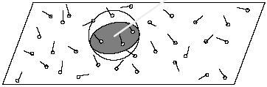
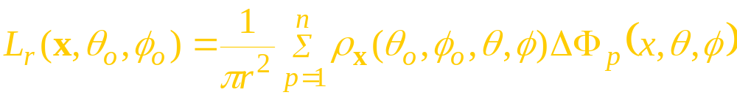
Radiance Estimate
Find a sphere around x containing n photons.
Use these n photons to estimate the radiance.
Photon p has power ΔΦ_{p}
Notes:
Sometimes 2D disks are used instead of spheres
Lr is reflected radiance (emittance is ignored here)

Slide 29
Estimate Filtering
Averaging samples creates blur
  Good for radiosity, they are smooth
  Not so good for caustics, they have sharp boundaries
Use weigted averaging
Use differential filters
  Detect edges from the samples
  “Zero” weights for samples outside edges

Slide 30
Rendering
Perform a single step of secondary illumination

Slide 31
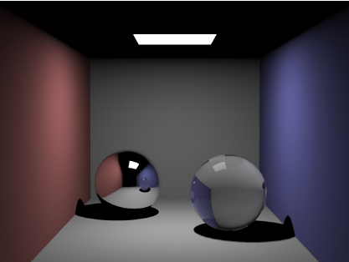
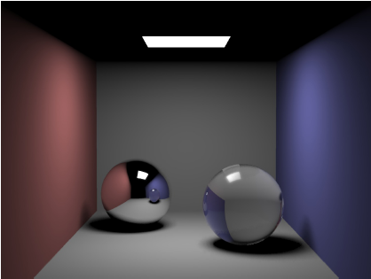
Examples
Raytraced Cornell box
Sharp shadows
Raytraced Cornell box
Soft shadows
Images courtesy of Henrik Wann Jensen

Slide 32
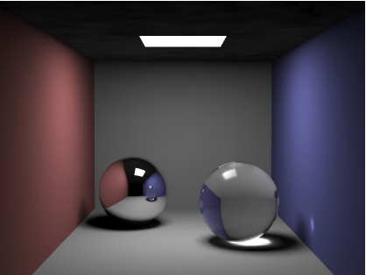
Caustic Photon Map
Photon map has 50000 photons and the estimate uses
60 photons
Images courtesy of Henrik Wann Jensen

Slide 33
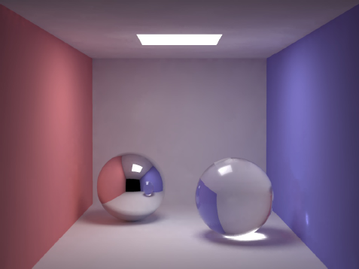
Global Illumination with Photon Map
200000 photons in the global photon map. 100 photons used in the estimate.
Images courtesy of Henrik Wann Jensen

Slide 34
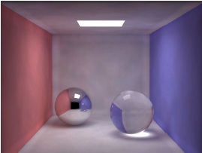
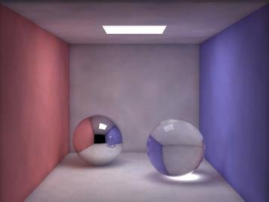
Photon Neighborhood
Sphere Estimate
Disk Estimate
Global photon map radiance estimates visualized directly using 500 photons
Images courtesy of Henrik Wann Jensen

Slide 35
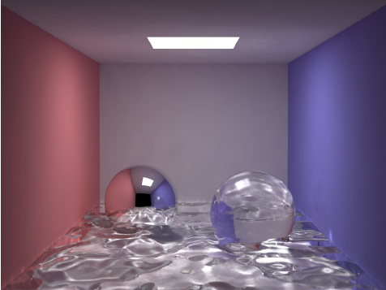
Cornell Box with Water
Displacement-mapped water surface (20,000 tris). 500,000 photons in both the caustics and the global photon maps, and 100 photons in the radiance estimate.
Images courtesy of Henrik Wann Jensen

Slide 36
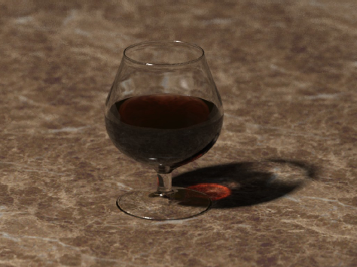
Cognac Glass and Caustic
Glass made with 12000 triangles. 200,000 photons in the map. The radiance estimates with 40 photons.
Images courtesy of Henrik Wann Jensen

Slide 37
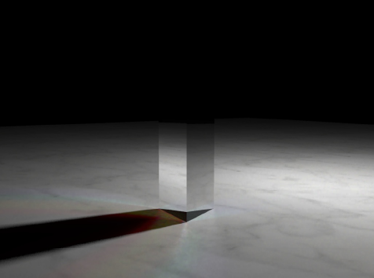
Caustic through Prism Dispersion
Only three separate wavelengths have been sampled. 500, 000 photons in the caustics and 80 photons in the radiance estimate.
Images courtesy of Henrik Wann Jensen

Slide 38
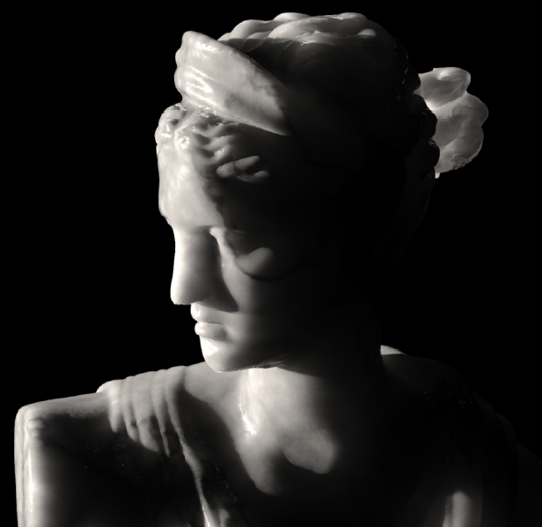
Diana, the Huntress
Light behind translucent marble. (200,000 photons)

